Slide 1
MINIPROJECT
Team-15
Name:- T. Karthik Reddy
P.Santosh Naik
Roll No : 1602-19-737-137
1602-19-737-163
Section:- IT_C

Slide 2
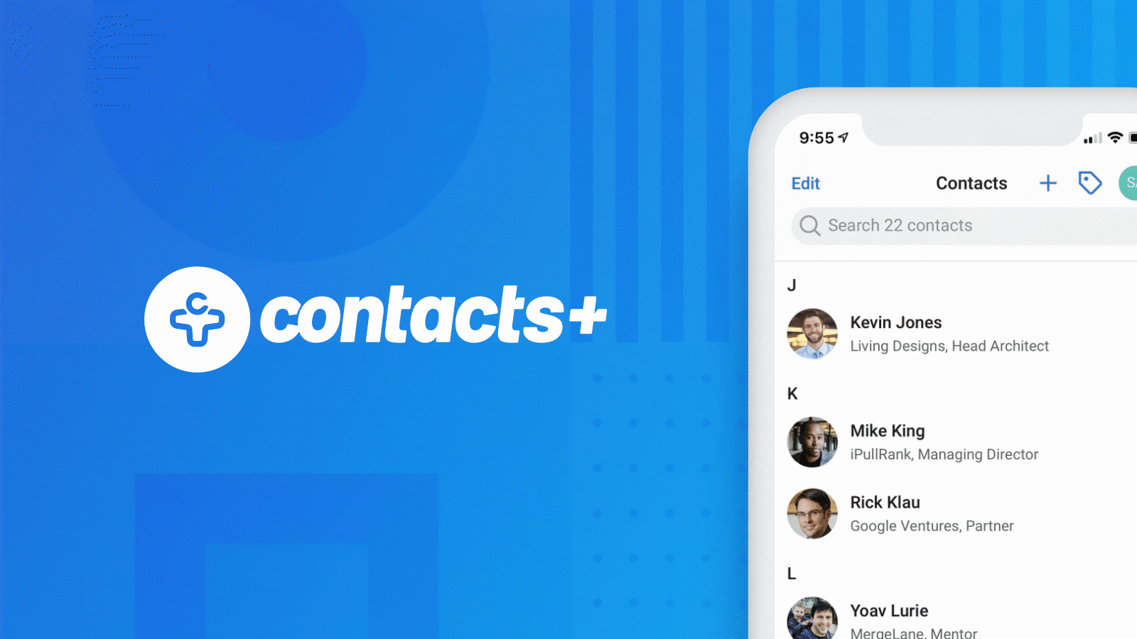


Slide 3
ABSTRACT About Phonebook Mini Project in C:
Phonebook is a very simple mini project in C that can help you understand the basic concepts of functions, file handling and data structure. This application will teach you how to add, list, modify or edit, search and delete data to/from the file.
Adding new records, listing them, modifying them and updating, search for contacts saved, and deleting the phonebook records are the basic functions which make up the main menu of this Phonebook application.
Github links :-
137-karthikreddy https://github.com/KarthikReddy1111
163-santosh:- https://github.com/santhoshchavan/

Slide 4
Actor wise use case
Register
Login
Add new contact
List contacts
Exit to Home
Modify contacts
Search contacts
Delete contacts
USER
ADMIN
Login
View Users
Delete Users
Access to all registered user’s credentials

Slide 5
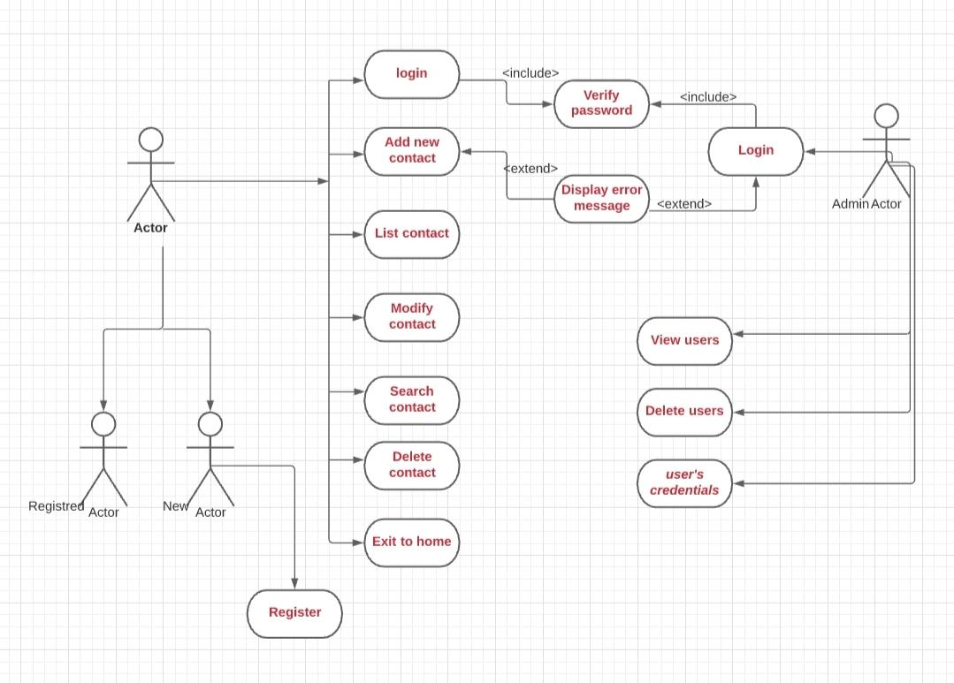
CONTACTS MANAGEMENT

Slide 6
USER

Slide 7
Usecase-1
Name : Register
Actor : User Description : Allows new user to register for an account
Pre-conditions : None
Post-conditions : An account is created for the user
Main flow :
USER : | SYSTEM :
Chooses sign-up option
 | Prompts user to enter required information
Enters required information prompted by system
 | A message saying account is created

Slide 8
Usecase-2
Name : Login
Actor : User Description : Allows registered users to access features
Pre-conditions : User must be registered
Post-conditions : Menu is displayed and must enter the use case number within the limit.
Main flow :
USER : | SYSTEM :
Enters username and password
 | Validates the credentials entered by user and i) Displays main menu if the credentials are valid ii) Display a error message saying invalid credentials

Slide 9
Usecase-3
Name : add new contacts
Actor : User Description : Allows users to add new contacts
Pre-conditions : User must be successfully logged in
Post-conditions : allowing to add new contacts is displayed on console
Main flow :
USER : | SYSTEM :
Selects the add contacts option
 | Displays add a new contact and Prompts user to add new contact and all the details like phone number, address , email ,gender ,citizenship number ,fathers name , mothers name etc.

Slide 10
Usecase-4
Name : Listing all the contacts
Actor : User Description : Allows users to list all the contacts
Pre-conditions : User must be successfully logged in and their must be contacts available.
Post-conditions : allowing to list all the contacts is displayed on console
Main flow :
USER : | SYSTEM :
Selects the list contacts option
 | Displays the list of all the contacts that are created.

Slide 11
Usecase-5
Name : Modify the contacts and their details
Actor : User Description : Allows users to Modify the contacts and their details
Pre-conditions : User must be successfully logged in and their must be contacts available
Post-conditions : allowing to Modify the contacts and their details
on console
Main flow :
USER : | SYSTEM :
Selects the modify contacts option
 | Display to modify the contacts and their details like phone number, address , email ,gender ,citizenship number ,fathers name , mothers name etc.

Slide 12
Usecase-6
Name : search the contacts and their details
Actor : User Description : Allows users to search the contacts and their details
Pre-conditions : User must be successfully logged in and there must be a contacts available
Post-conditions : allowing to search the contacts and their details
on console
Main flow :
USER : | SYSTEM :
Selects the search contacts option
 | Display to search the contacts and their details like phone number, address , email ,gender ,citizenship number ,fathers name , mothers name etc.

Slide 13
Usecase-7
Name : Delete the contacts and their details
Actor : User Description : Allows users to delete the contacts and their details
Pre-conditions : User must be successfully logged in and there must be a contacts available
Post-conditions : allowing to delete the contacts and their details
on console
Main flow :
USER : | SYSTEM :
Selects the delete contacts option
 | Display to delete the contacts and their details like phone number, address , email ,gender ,citizenship number ,fathers name , mothers name etc.

Slide 14
Usecase-8
Name : Exit to the home
Actor : User Description : Allows users to Exit to the home and again perform the other use case
Pre-conditions : User must be successfully logged in and there must be a contacts available
Post-conditions : allowing to Exit to the home
on console
Main flow :
USER : | SYSTEM :
Selects the Exit to the home option
 | Displays the home screen and allows user to again perform the other use case.

Slide 15
ADMIN

Slide 16
Usecase-9
Name : Login
Actor : Admin Description : Allows admin to login
Pre-conditions : None
Post-conditions : A menu customized for admin is displayed
Main flow :
USER : | SYSTEM :
Enters Admin username and password
 | Validates the credentials entered by user and i) Displays customized admin menu if the credentials are valid ii) Display a error message saying invalid credentials

Slide 17
Usecase-10
Name : Login
Actor : Admin Description : Allows admin to look at the users list
Pre-conditions : There must be users created
Post-conditions : Users list is displayed
Main flow :
USER : | SYSTEM :
Selects the list users option
 | Displays the list of the users that are created.

Slide 18
Name : Delete complete/particular user
Actor : Admin Description : Allows admin to delete user.
Pre-conditions : There must be a user available
Post-conditions : The selected user will be deleted
Main flow :
USER : | SYSTEM :
Selects delete user option
 | Prompts admin to delete either any or all users
Admin enters their choice
 | Deletes particular user

Slide 19
thank you

